Slide 1
Centrifugation & Sedimentation
Theory & Non-Aspen Simulation

Slide 2
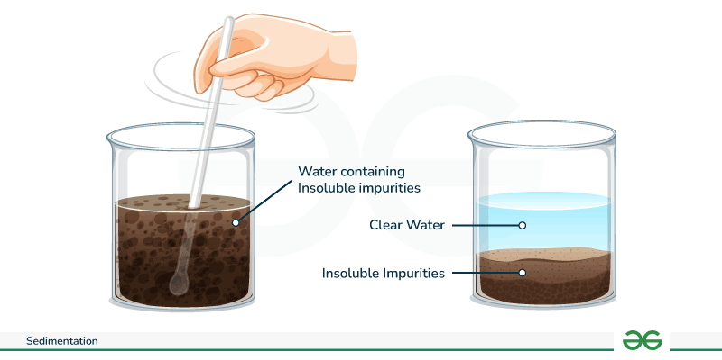
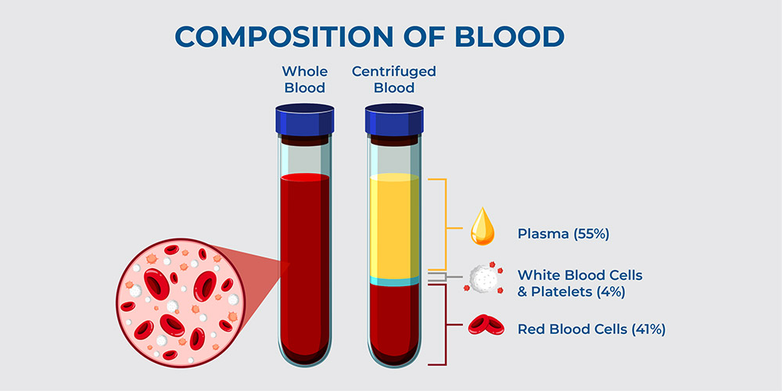
What are they used for?
Mechanical separation processes used to separate heterogeneous liquid+solid mixtures
Can be both a continuous process or a batch process
Sedimentation
Driven by gravity
Slow separation of large particles
Centrifugation
Driven by centrifugal force
Fast separation of small particles
https://www.geeksforgeeks.org/sedimentation/#google_vignette
https://www.accumaxlab.com/clinical-centrifuges-advancing-modern-science/
Notes:
Centrifuge Image: https://www.accumaxlab.com/clinical-centrifuges-advancing-modern-science/
Sedimentation Image: https://www.geeksforgeeks.org/sedimentation/#google_vignette

Slide 3
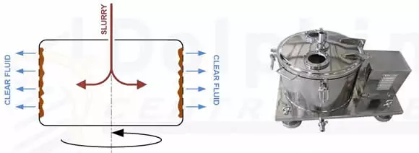
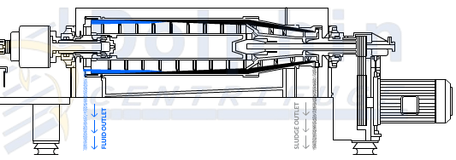
Industrial Centrifuges
Filtration Type
Sedimentation Type
Liquid passes through by force and solids are retained in a filter
Examples:
Vertical
Pusher
Basket
Peeler
Differential settling to separate the solids and liquids with no filter
Examples:
Decanter
Disk-Stack
Solid-Bowl Basket
Tubular Bowl
Industrial Centrifuge Types, Applications, Cost & Benefits. https://dolphincentrifuge.com/industrial-centrifuge/

Slide 4
How to Pick a Centrifuge
Filtration Type
Sedimentation Type
Limited by the filter size since solid particles need to be larger than filter
Filter needs to be replaced
Lower g-force required (< 2,000 Gs)
Solid recovery is generally the priority more favorable for food and pharmaceutical production
Often batch operated
Filter media may not be environmentally friendly
Relies on centrifugal force, so a wide range of solid particle sizes can be separated
Less maintenance, more energy-intensive
Higher centrifugal force (RCF) required (3,000 to 10,000 Gs)
Liquid recovery is generally the priority
More favorable for wastewater and chemical processing
Better for fine or sticky particles
Continuous operation
Chemical additives may be required
Initial and Operating Cost
Size
Waste Disposal
Industrial Centrifuge Types, Applications, Cost & Benefits. https://dolphincentrifuge.com/industrial-centrifuge/

Slide 5
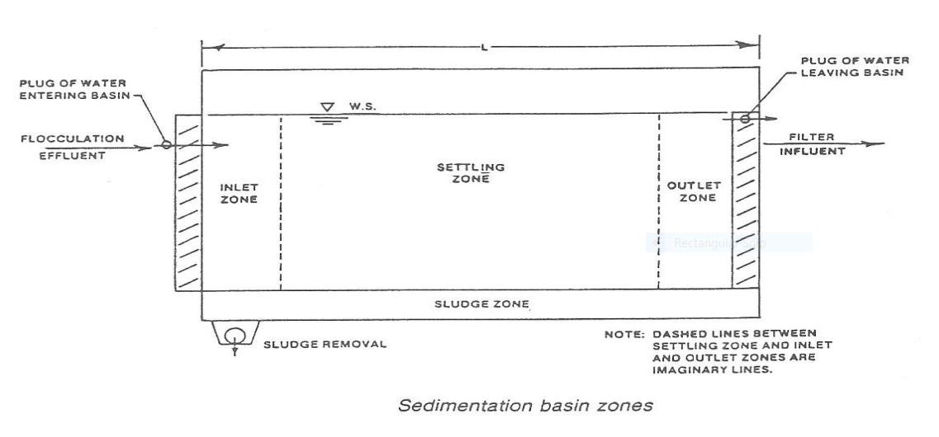
Industrial Sedimentation
Primary Sedimentation: Remove settleable particles (50-75% TSS removal efficiency)
Secondary: Remove biomass; further downstream
Particle Settling
Free Settling: TSS <600 mg/L
Flocculent Settling: TSS 600-1,200 mg/L
Hindered or Zone Settling: TSS 1,200-5,000 mg/L
Compression Settling: TSS >5,000 mg/L
https://www.mrwa.com/WaterWorksMnl/Chapter%2013%20Sedmentation.pdf

Slide 6
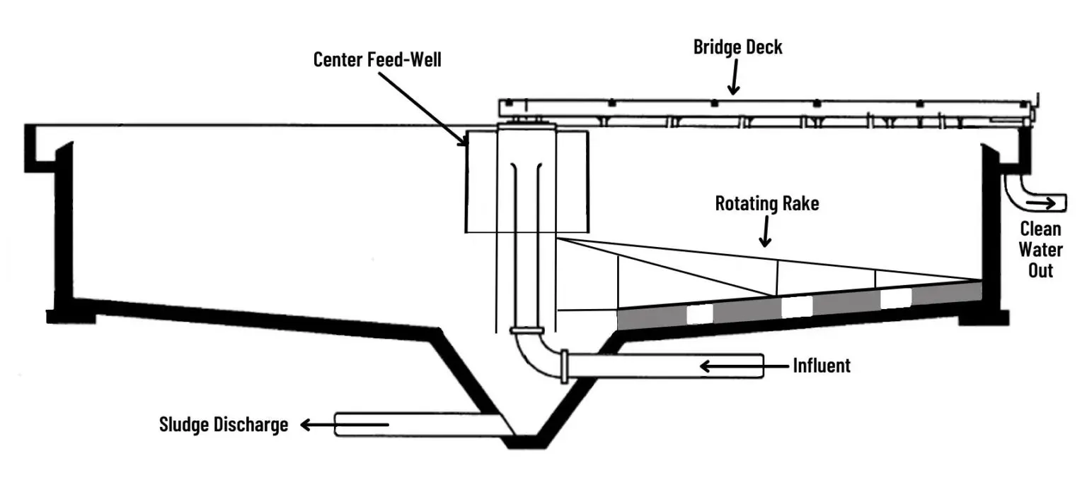
Design Considerations
Geometry
Circular (radial flow): Center & Peripheral-feed
Rectangular (longer flow path): Sludge hopper location
Flow Rate & Detention Time
High flow, low detention time: risk solids not settling, lowering efficiency
Low flow, high detention time: risk solids becoming compacted & difficult to remove
Sludge Removal Systems
Scrapers: Primary sedimentation uses only this
Suction Pipe
Suction Header
Chemical Treatments
Coagulants: Neutralize particles’ negative charge
Flocculants: Particles/colloids create longer particle chains
Metal salts & polymers
https://www.mrwa.com/WaterWorksMnl/Chapter%2013%20Sedmentation.pdf
https://clearwaterind.com/how-sedimentation-water-treatment-works-and-how-to-make-it-efficient/

Slide 7
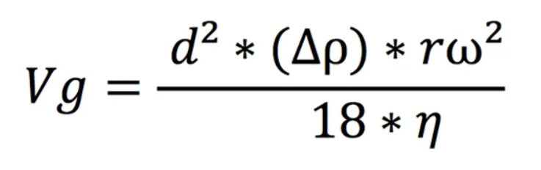
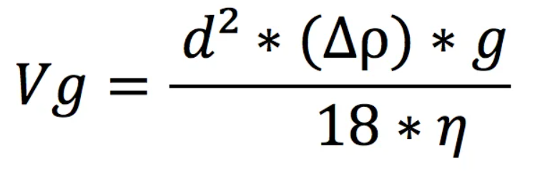
Equations
Rate of particle separation by sedimentation
Rate of particle separation by centrifugation
The rate of separation in both sedimentation and centrifugation can be determined using Stokes Law
Both are proportional to particle diameter (d), the difference in density between the particle and the solution (Δ⍴), and the viscosity of the solution (η)
The only difference between the equations is that sedimentation uses the gravitational force (g) and centrifugation utilizes centrifugal force determined by the radius of the centrifuge (r) and the angular velocity of the centrifuge (⍵)
https://www.flottweg.com/wiki/separation-technology/sedimentation-speed/
Notes:
Eqns:
https://www.flottweg.com/wiki/separation-technology/sedimentation-speed/

Slide 8
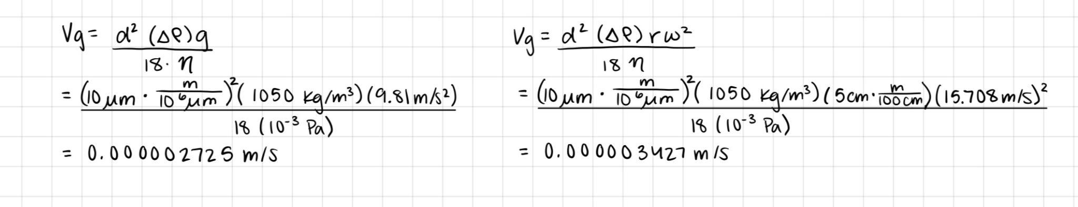
Example w/ numbers
A very common use for a centrifuge might be to isolate your cells (pellet) from the rest of your growth media
Assume you have grown cells in a growth medium with density and viscosity similar to water. The cells grew to be 10 micrometers in diameter with a density of 1050 kg/m³. Let’s compare the difference between separation by sedimentation and centrifugation. Assume you use a 5 cm radius centrifuge at a speed of 3000 RPM.

Slide 9
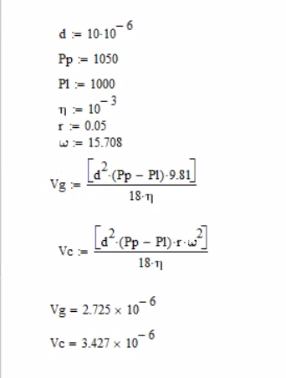
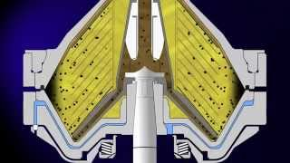
Simulations that can be used
Here is a Mathcad code designed to solve for the rate of separation of sedimentation and centrifugation with the example numbers
https://www.youtube.com/watch?v=snVkTBzUWDY

Slide 10
Centrifugation & Sedimentation Applications
Separate cells from media
Recovery of 2-phase material
Common step in industrial applications to isolate a single solid phase after adding reactant
Used to wash particles
Wastewater treatment

Slide 11
Thank you!
Questions?

Slide 12
Resources
https://www.accumaxlab.com/clinical-centrifuges-advancing-modern-science/
https://www.geeksforgeeks.org/sedimentation/#google_vignette
https://evsujpiche.wordpress.com/wp-content/uploads/2014/06/unit-operations-of-chemical-engineering-5th-ed-mccabe-and-smith.pdf
https://www.eng.uc.edu/~beaucag/Classes/ChEThermoBeaucage/Books/(McGraw-Hill%20Chemical%20Engineering)%20C.%20Judson%20King%20-%20Separation%20Processes-McGraw-Hill%20(1980).pdf
https://dolphincentrifuge.com/industrial-centrifuge/
https://filtrationservices.co.uk/centrifuge-filtration/
https://www.sigmaaldrich.com/US/en/technical-documents/technical-article/protein-biology/protein-pulldown/centrifugation-basics?srsltid=AfmBOopYYE38VAT-VvxJZ2c1-UrscvJKPjNddx5DDlOro4diIeEdvhKb
https://www.youtube.com/watch?v=snVkTBzUWDY
https://www.wef.org/globalassets/assets-wef/direct-download-library/public/03---resources/wsec-2017-fs-022-liquid-stream-fundamentals--clarification-sedimentation_final.pdf
https://www.mrwa.com/WaterWorksMnl/Chapter%2013%20Sedmentation.pdf
https://clearwaterind.com/how-sedimentation-water-treatment-works-and-how-to-make-it-efficient/
https://www.netsolwater.com/what-are-the-different-types-of-sedimentation-tanks.php?blog=2531&srsltid=AfmBOopYfUqNjjI-KGQq2xBA_1WCmar6Bag9EALNsvZsC_Y5_k4Uxnfs
https://www.flottweg.com/wiki/separation-technology/sedimentation-speed/

